Slide 1
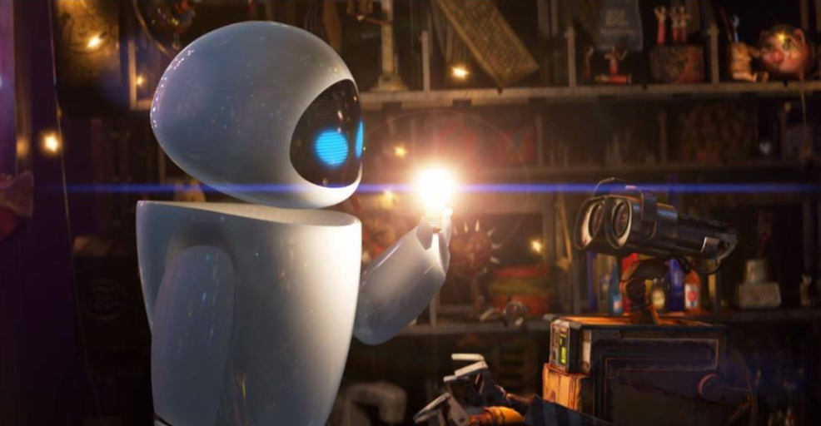
White Illusion
Py-Emotion:Persona #2
PsychoPy Workshop
Y.K.Lee
2018.07.31
@PyEmotion

Slide 2
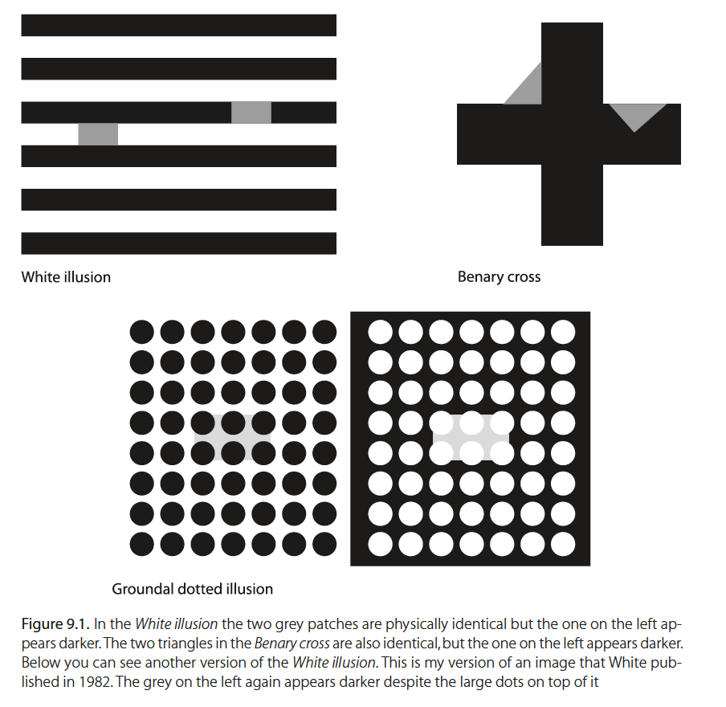
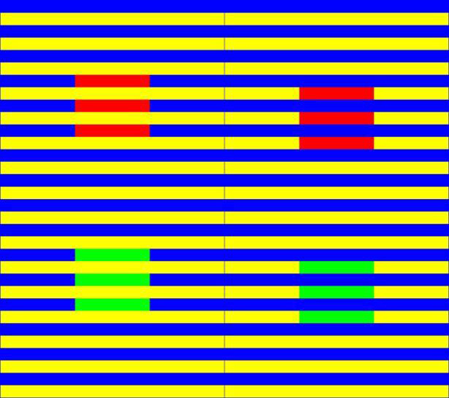
Many versions of colour illusions
The black and grey version.
The White illusion (“black and grey”)
Australian psychologist Micheal White (1979)
The Munker illusion (colorful one)

Slide 3
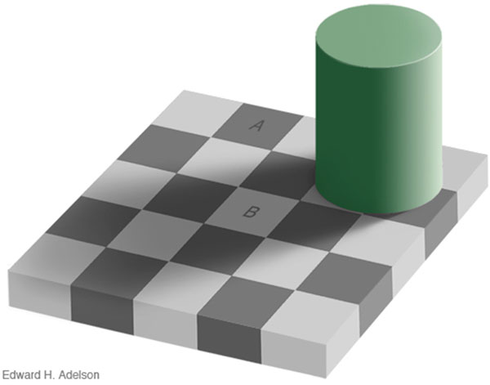
Illusion occurs because surrounding color can yield an effect.
Lateral inhibition (Kingdom 1997)
The response to one stimulus is strengthened or weakened by the presence of a similar or different response in neighboring regions (“lateral” refers to side by side spatial position).
Adelson EH (1993)

Slide 4
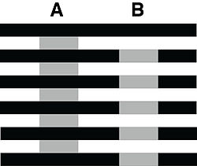
Simultaneous brightness contrast effect (“SBC”)
A grey patch surrounded by black appears brighter than the same grey patch surrounded by white.
The reason why we call this ‘contrast’ effect, and use the word ‘simultaneous’ is because we will look at the images side by side, at the same time.

Slide 5
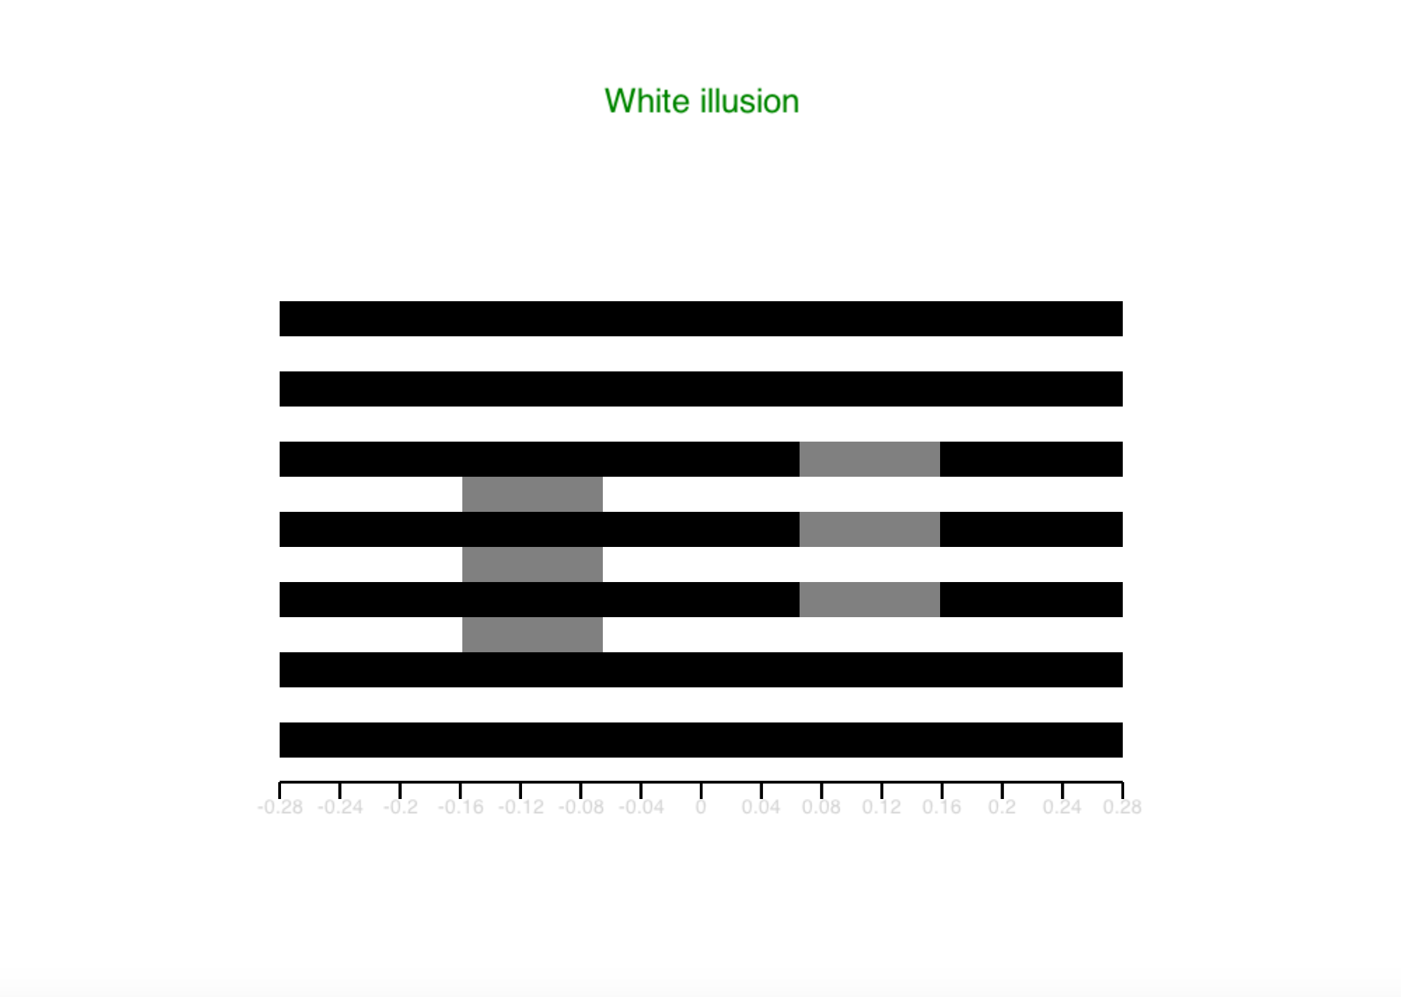
시작화면 (no key-press)

Slide 6
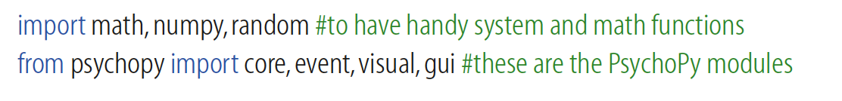
Import()
Define objects & functions
Def. mainloop ()

Slide 7
Import()
Define objects & functions
Def. mainloop ()

Slide 8
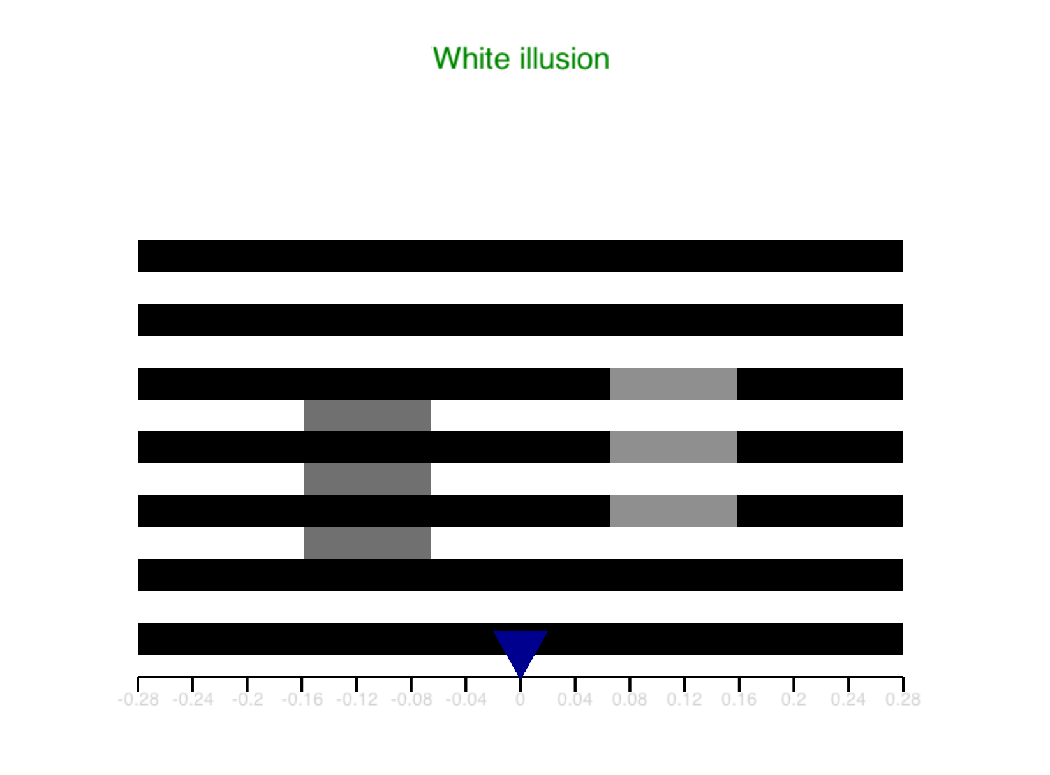
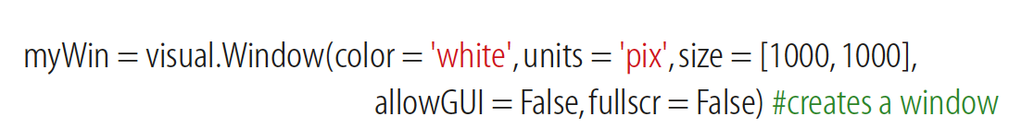
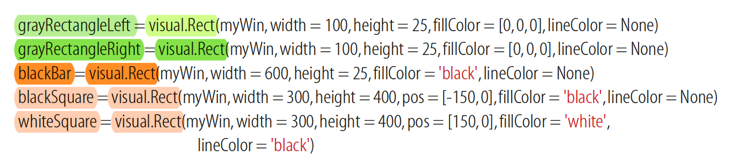
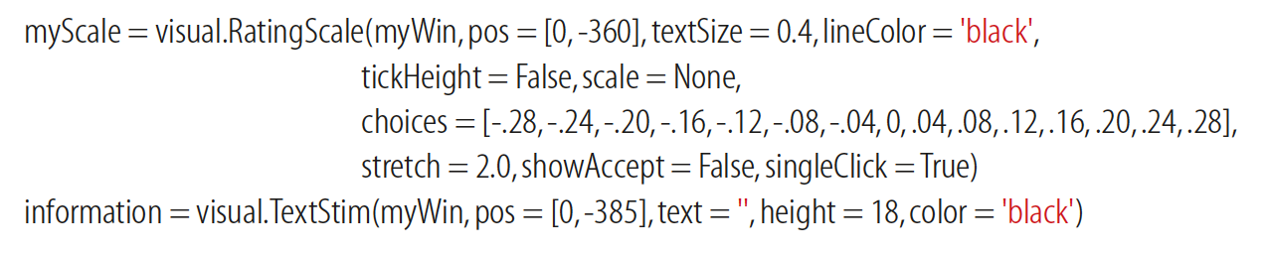
오브젝트 정의

Slide 9
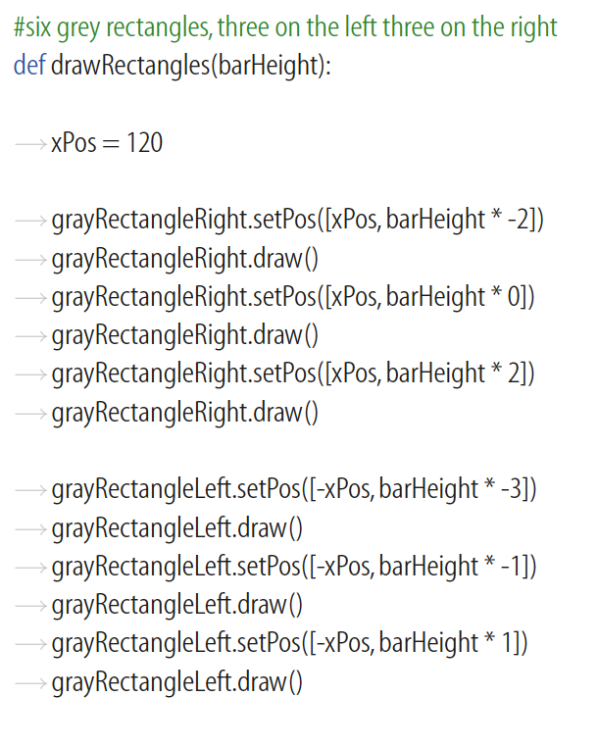
함수 정의 (1)

Slide 10
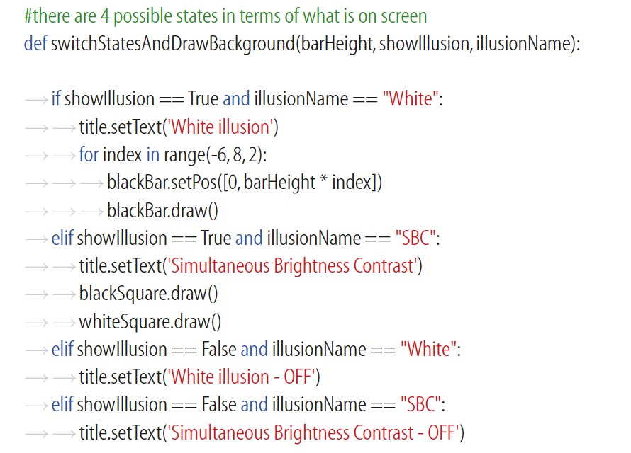
함수 정의 (2)
“showIllusion”
“illusionName”
[state]
“showIllusion” x “illusionName”
= “switchStatesAndDrawBackground

Slide 11
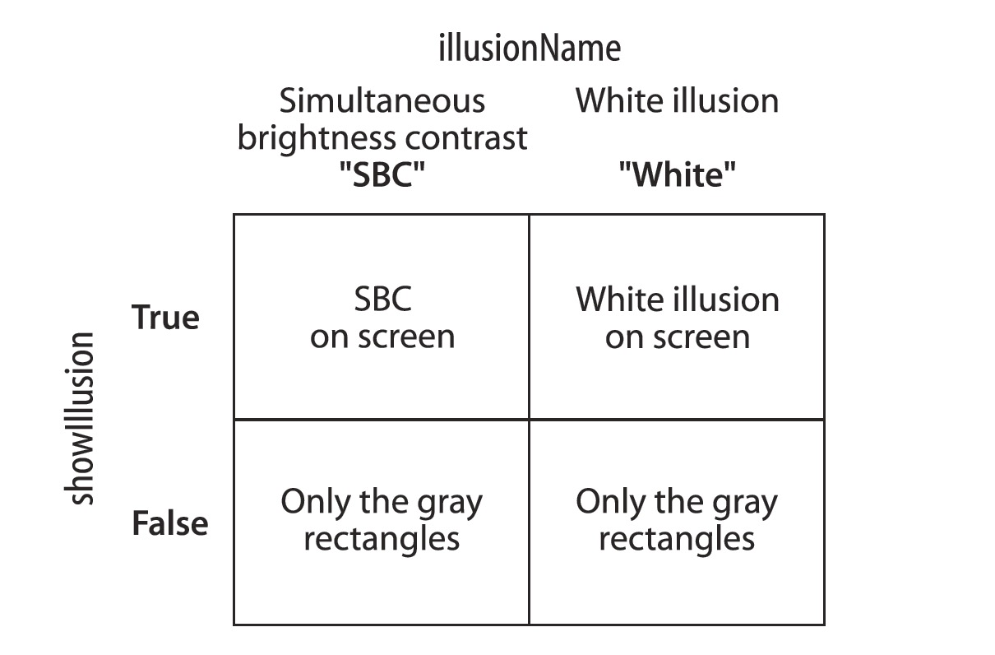

Slide 12
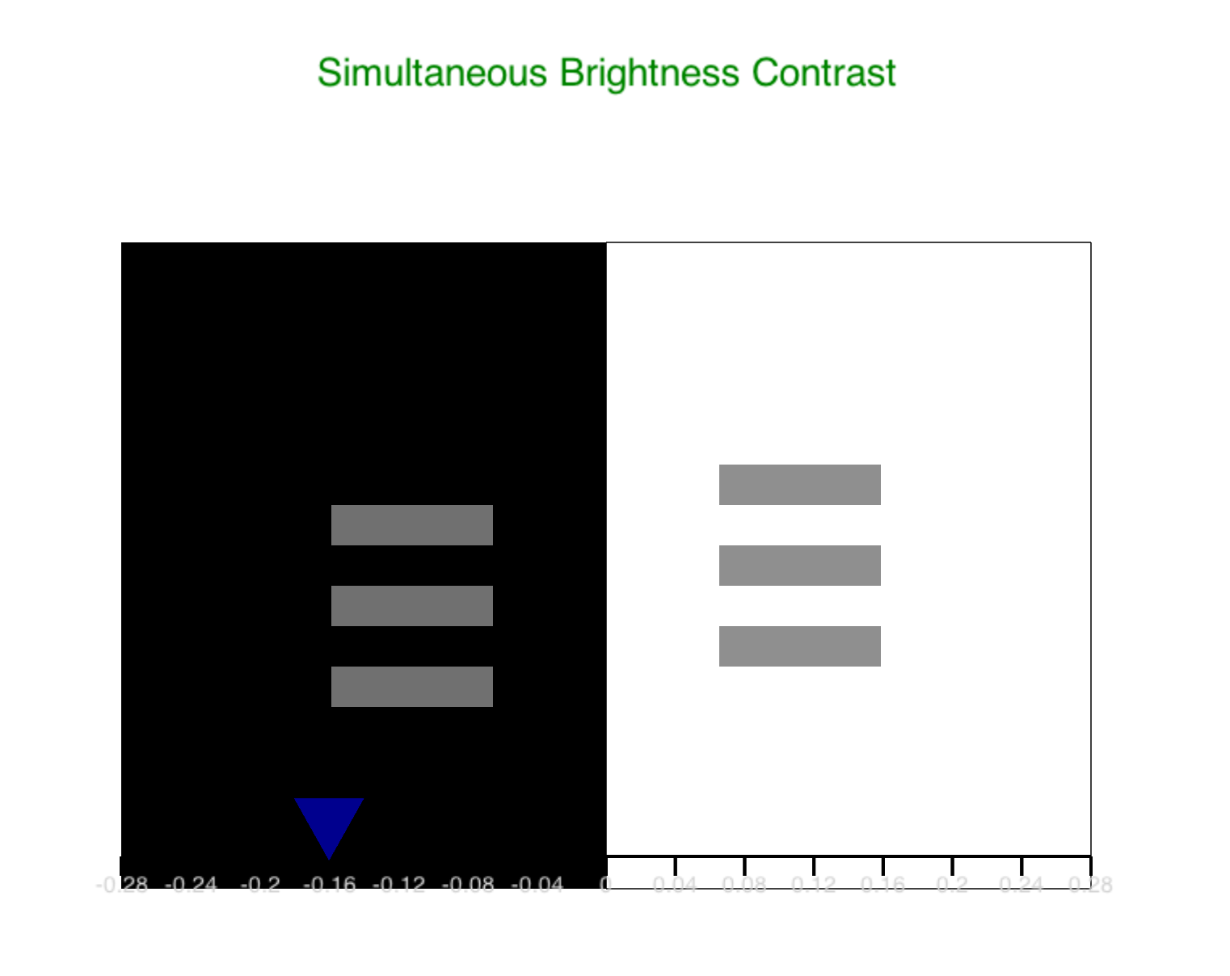
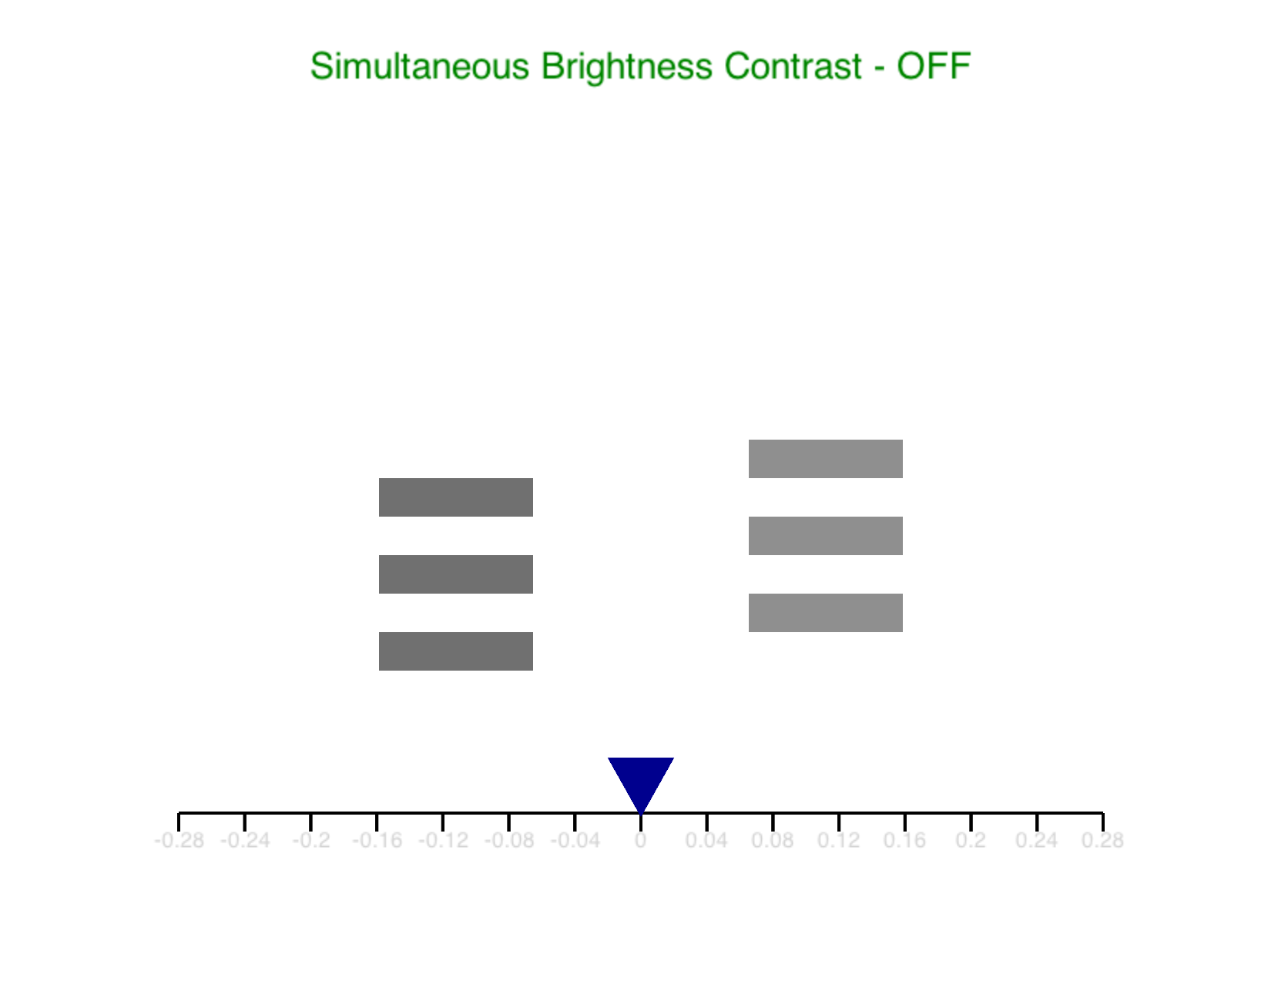

Slide 13
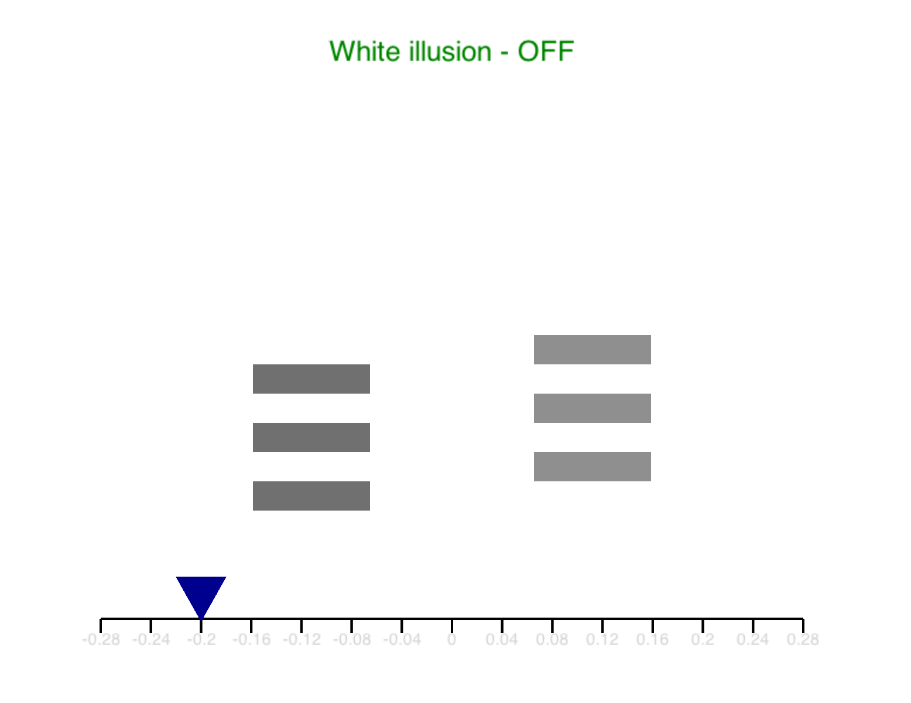
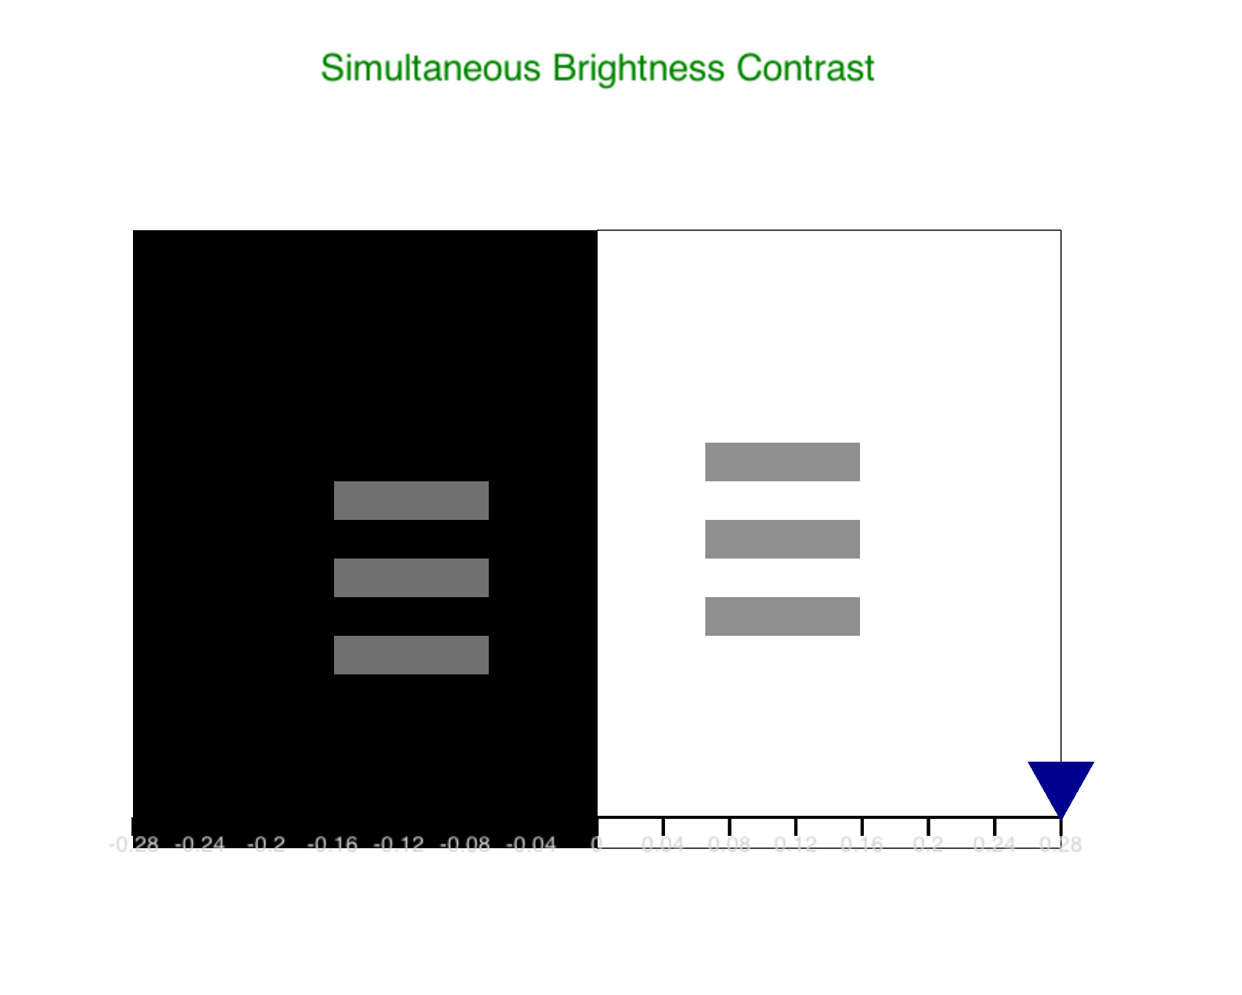
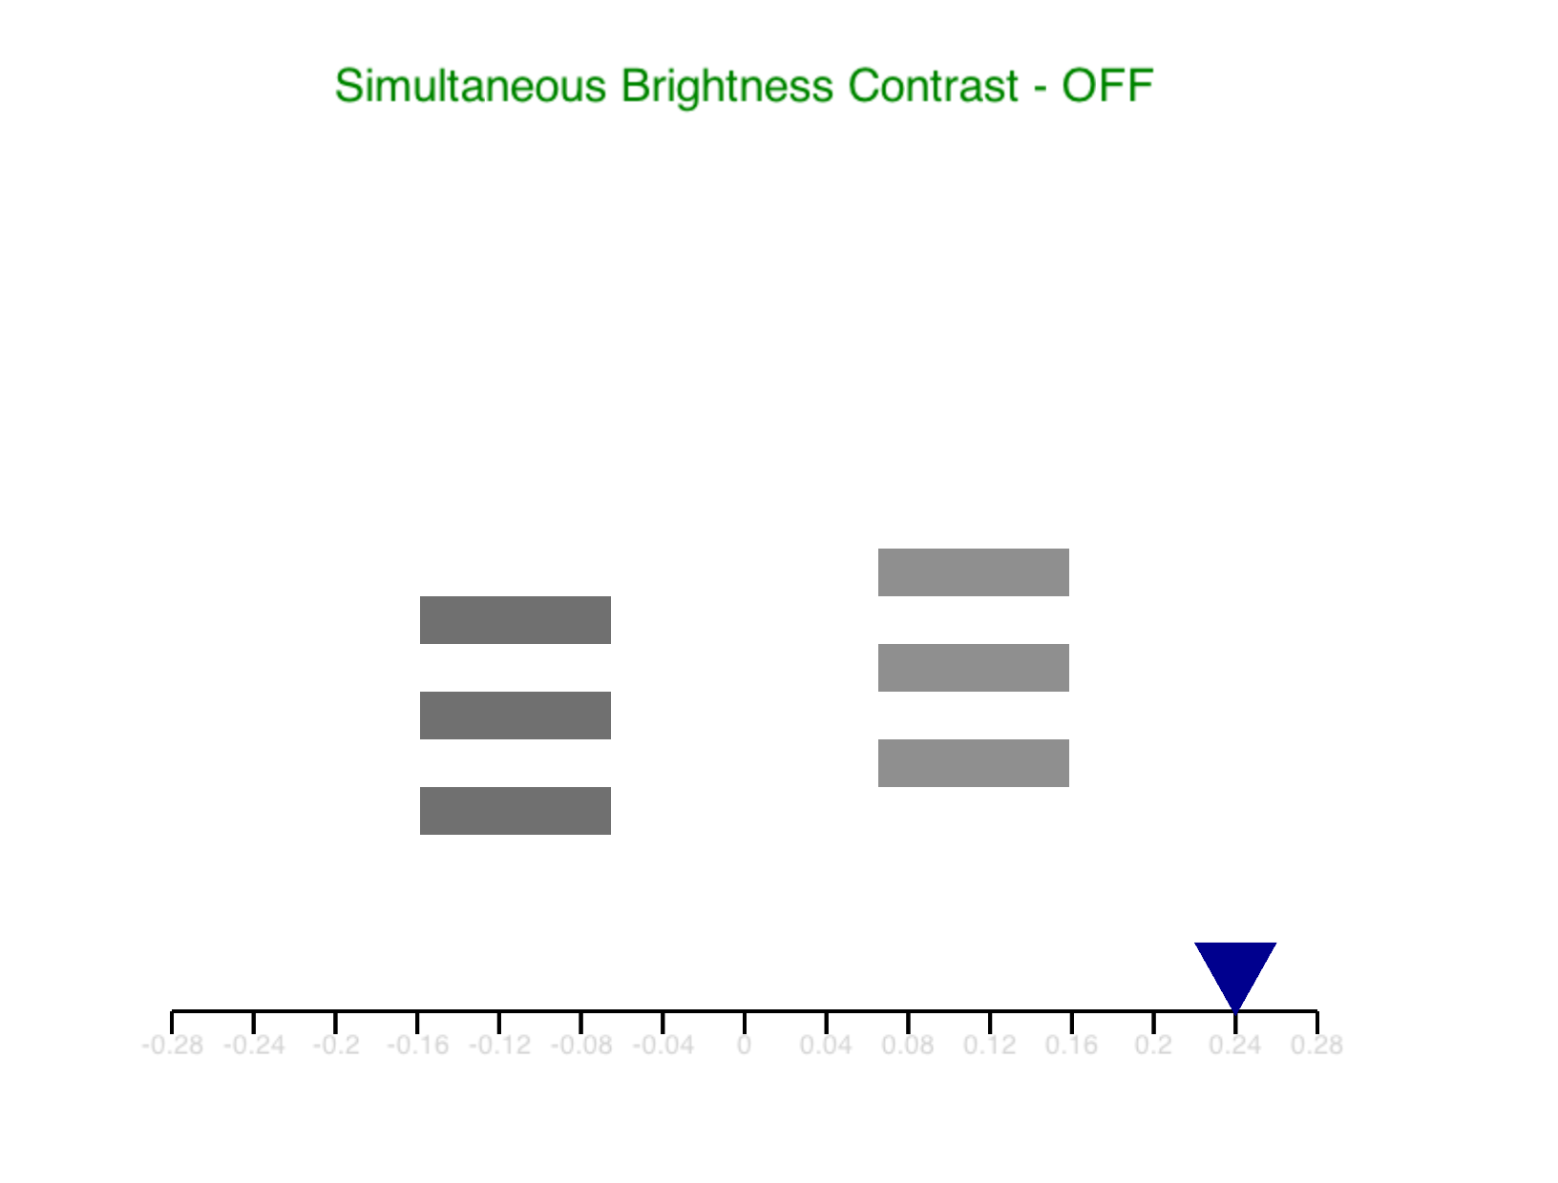
‘s’
‘a’
‘a’
‘’
‘s’

Slide 14
Import()
Define objects & functions
Def. mainloop ()

Slide 15
Import()
Define objects & functions
Def. mainloop ()
실행

